Slide 1
Body systems
Birth

Slide 2
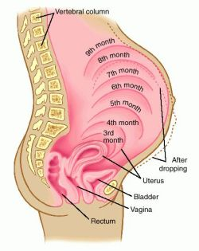
The final stages of a pregnancy

Slide 3
TERMINOLOGY:
Gestation = length of pregnancy
Parturition = birth
Labour - the birthing process
Neonate – Newborn infant
CHANGES IN PREPARATION FOR LABOUR AND BIRTH
Hormonal changes:
  Relaxation of ligaments in pelvis
  Increase uterine responses
Physical changes
  Baby’s head positioned within pelvis – “engaged”
  Cervix shortens and softens

Slide 4
Giving birth – parturition – How it Starts
Childbirth, or labor, is preceded by a rise in the levels of oestrogen and oxytocin in the mothers bloodstream.
Labour begins with contractions of the muscular walls of the uterus. These contractions start at the top of the uterus and sweep down to the cervix.
As labour progresses contractions become stronger and more frequent.

Slide 5
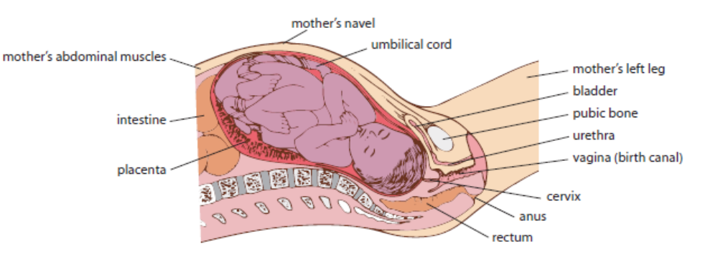
Foetus just before labour begins

Slide 6
Three stages of labour
Labour is often divided into three stages
1. Dilation
Contractions force the baby’s head into the cervix, stretching the cervix to a 10 cm opening. The head can then enter the birth canal (the vagina). (cervical dilation)
At this stage the ‘waters’ usually ‘break’ (i.e. the amnion bursts and releases the amniotic fluid)

Slide 7
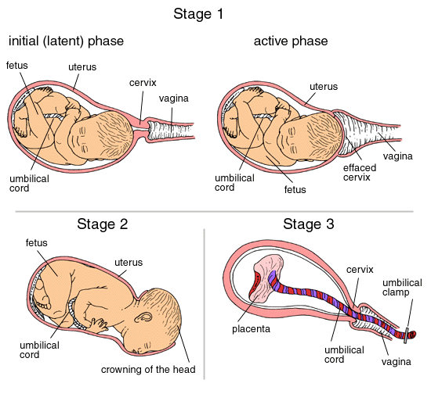

Slide 8
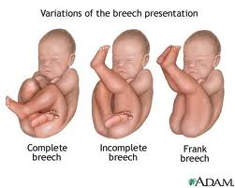

Slide 9
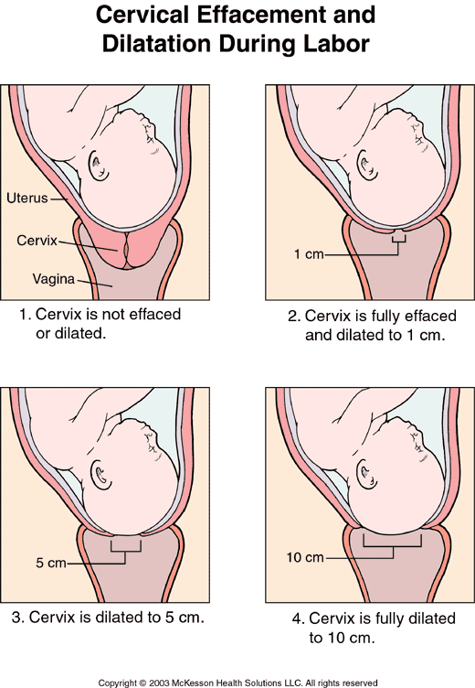

Slide 10
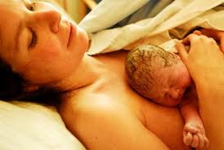
2. Expulsion
Contractions become stronger and more frequent
Lasts 10min – 2 hours
Often begins with the breaking of the amniotic sac “waters breaking”although this can happen at any time during labour.

Slide 11
Each contraction advances the head a small amount.
Head stretches entrance to vagina.
Tearing of tissues may occur at this point.
The head emerges the baby rotates side on so shoulders can follow.

Slide 13
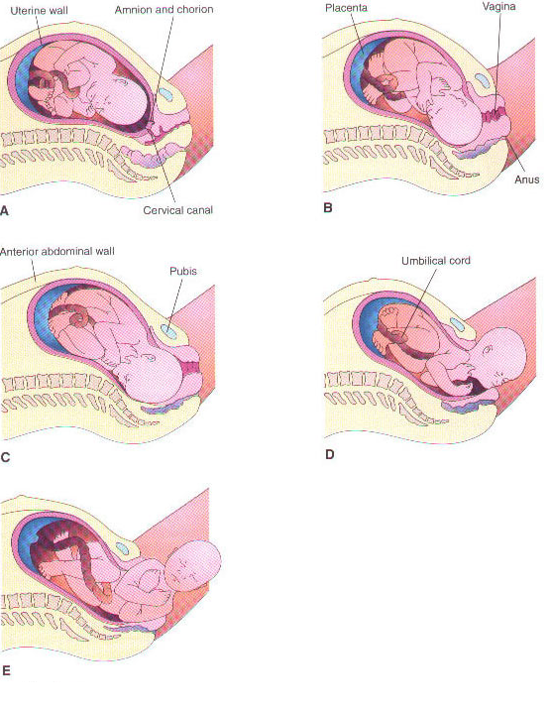
Images:
Second Stage of Labour
Notes:
http://www.youtube.com/watch?v=LjdG5lAcmOw
http://www.youtube.com/watch?v=w_7zqrnEQXY

Slide 14
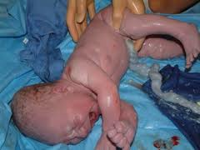

Slide 15
3. The placental stage
A final contraction of the uterus expels the placenta, umbilical cord and membranes (the after-birth) from the mother’s body.
(The navel or umbilicus is all that remains of the cord after a few days.)

Slide 16
Baby is out, but still connected to mother via umbilical cord.
At this stage, or after delivery of placenta the cord is cut.
Uterus continues to contract.
Blood vessels constrict as placenta comes away from uterine wall.
Blood clots form to stop any bleeding.

Slide 17
The newborn baby!
Covered in waxy substance called vernix – protects baby’s skin and insulates from cold.
Average 50cm long, 3.3kg.
Poor muscle control – head flops and legs dangle if held upright.
Cries to communicate
Can see, but not well. Other senses working well.
Strong sucking reflex, seeks breast to feed.

Slide 18
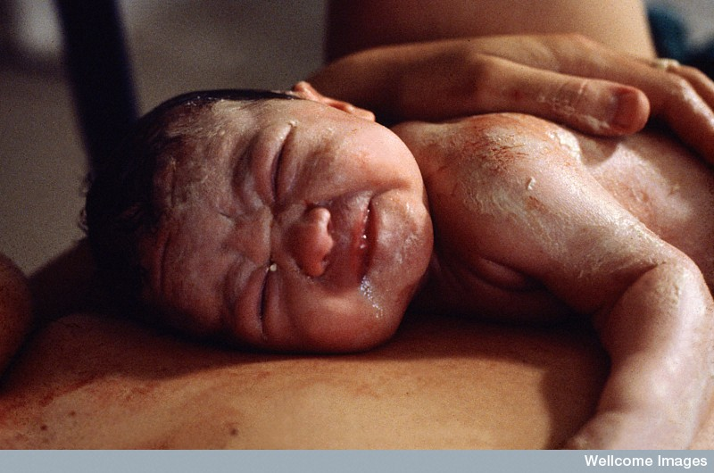
Newborn – the neonate
The vernix is a protective layer of wax covering the babies skin
Anthea Sieveking, Wellcome Images

Slide 19
The blood-circulatory system
At birth the following circulatory changes take place:
  The umbilical arteries and vein stop functioning
  The hepatic shunt (ductus venosus) closes and the hepatic circulation becomes fully functional
  The two cardiac shunts (ductus aeteriosus & foramen ovale) close and the pulmonary circulation becomes fully functional

Slide 20
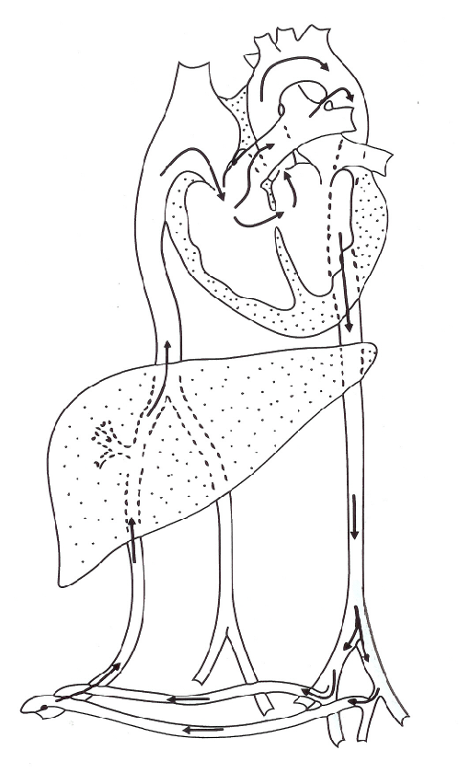
Changes in the circulation
Ductus arteriosus
Foramen ovale
Ductus venosus
Umbilical arteries and vein

Slide 21
Ductus Venousus
In the foetus this duct allows most blood to bypass the liver and enter the vena cava. At this stage the liver is not needed to fully function.
After birth this duct closes to allow all blood to flow through the liver.

Slide 22
Ductus Arteriosus
This duct is a by pass so that most blood does not need to travel to the lungs from the right ventricle. Instead it is able to join the aorta to travel to the foetus’s body.
After birth the blood needs to circulate through the lungs and so this duct closes.

Slide 23
Foramen Ovale
This is an opening in the heart that allows blood to travel directly from the right atrium into the left atrium and so on to the aorta. This is another short cut to avoid the lungs which are not functioning.
After birth this closes over. Children born where this fails to close are often called “hole in the heart” babies.

Slide 24
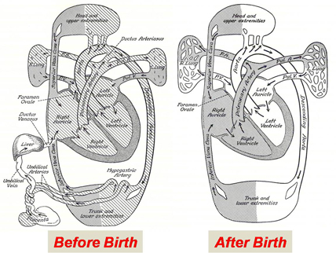

Slide 25
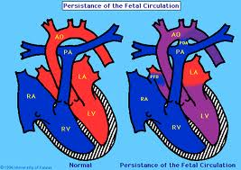

Slide 26
Change at birth
The process of being born causes a complex chain reaction in the babies body in order to suddenly survive in the outside world.
1. The shock of birth usually triggers the first breath ( if not the traditional slap on the bottom helps). In animals they are often vigorously licked by their mothers or in some cases such as in elephants, the fall from a great height helps the young to suddenly breathe for the first time.

Slide 27
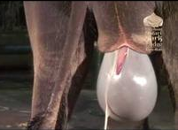
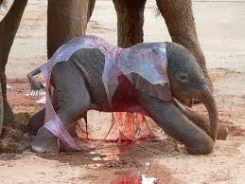

Slide 28
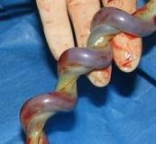
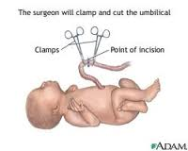
Failing this the clamping of the umbilical vessels allows the carbon dioxide in the baby’s blood to rise and so stimulate the reparatory centre in the brain – causing the lungs to start to function.

Slide 29
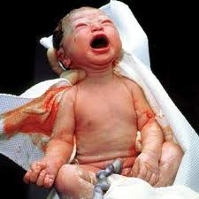
2. As the lungs expand they no longer offer the same resistance to blood flow, so blood flow through the ductus arteriosus is decreased. This duct will completely disappear a few weeks after birth.

Slide 30
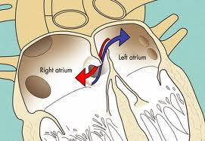
3. As large amounts of blood return from the lungs to the heart. The pressure in the left atrium increases. This increased pressure forces the flap of the foramen ovale against the wall of the atrium, closing the opening. Eventually this will close permanently.

Slide 31
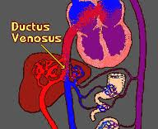
4. With the umbilical cord cut blood no longer flows through the umbilical vessels to the ductus venosus. Due to the lack of blood this duct gradually constricts and closes off. The bypass around the liver is then closed and all blood must now pass through the liver.

Slide 32
Caesarean Section
A C-section is where the baby is surgically removed from the uterus. This is done when:
The placenta is too low
The baby is overdue and no labour has started
When there is medical risks to mother or baby

Slide 33
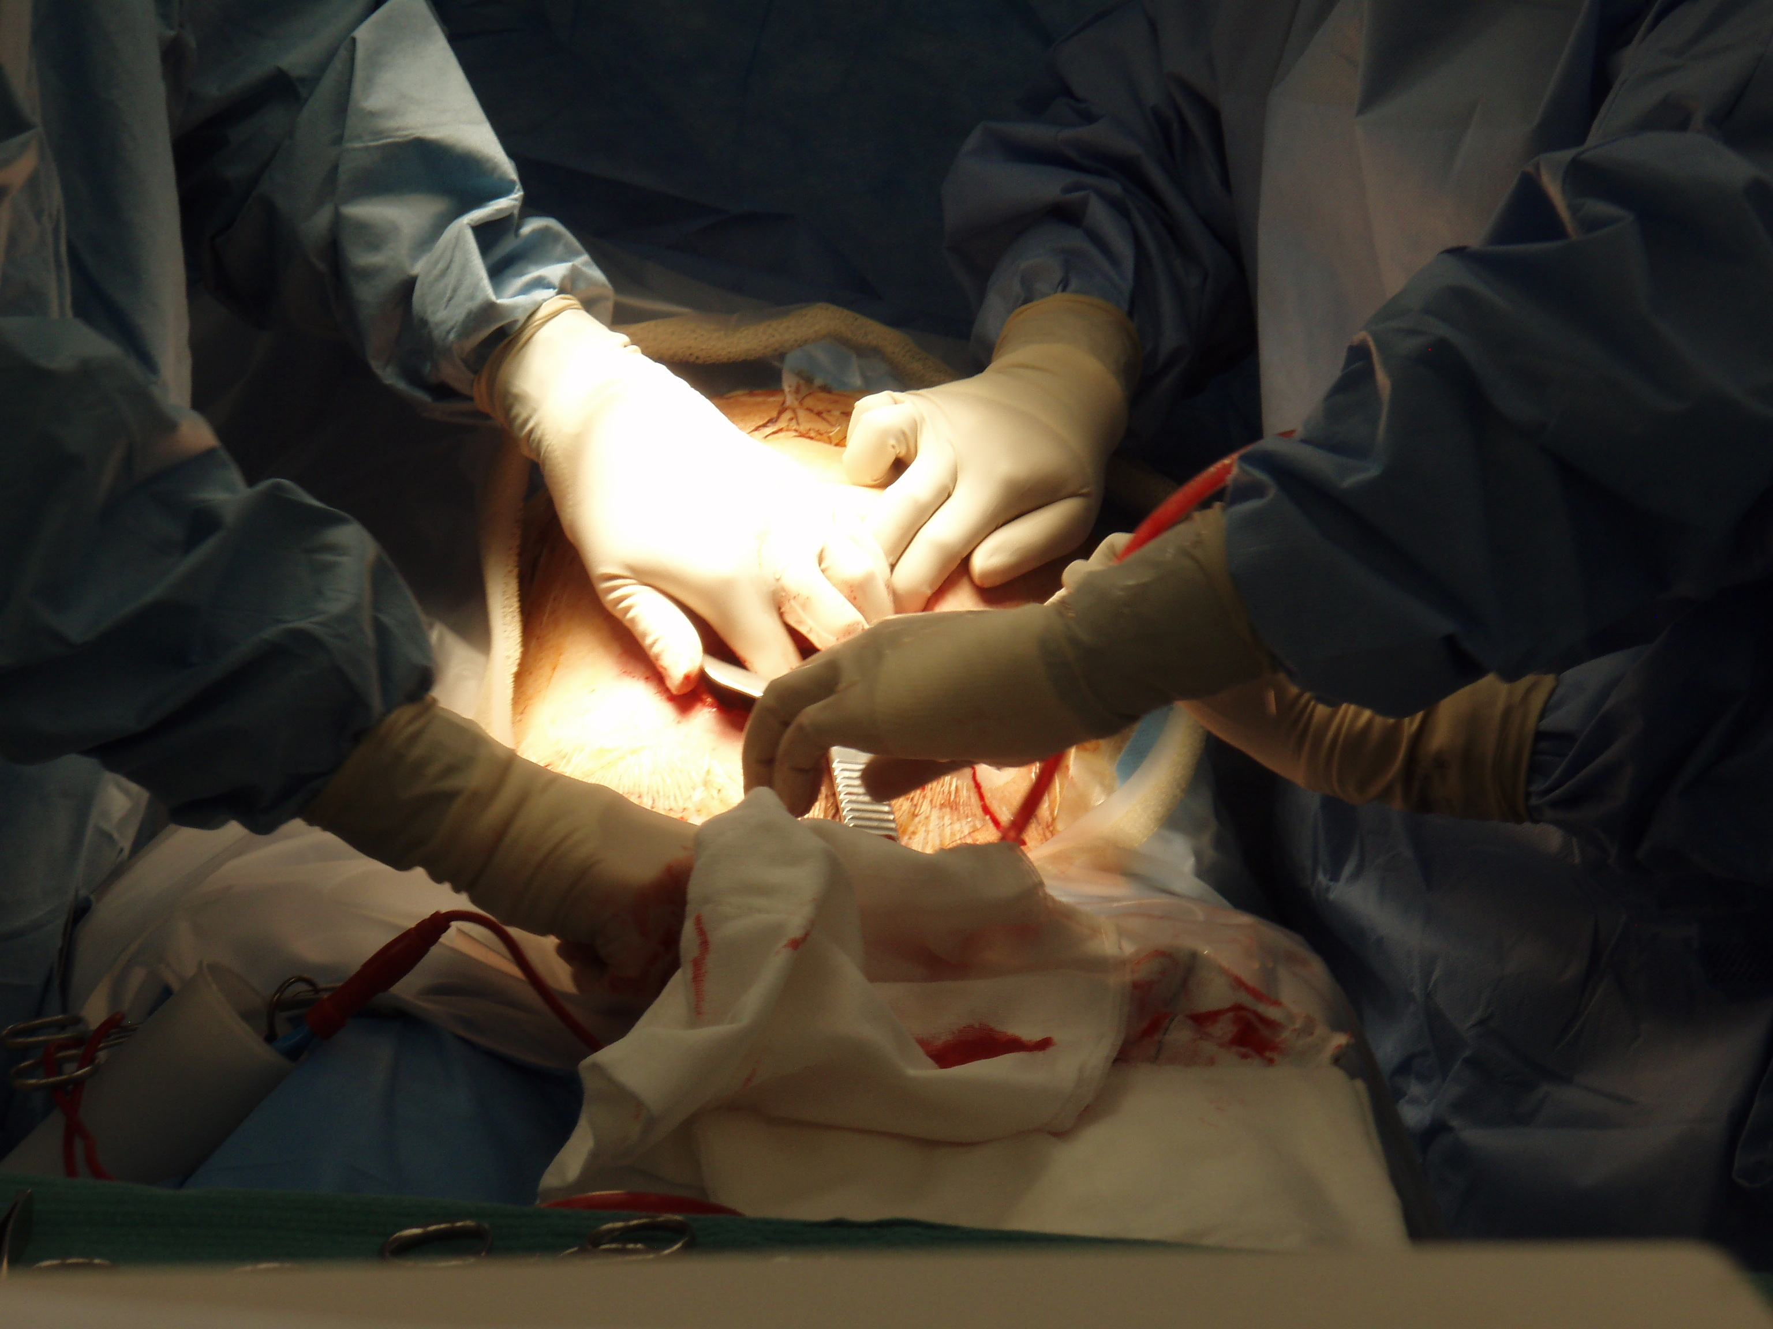

Slide 34
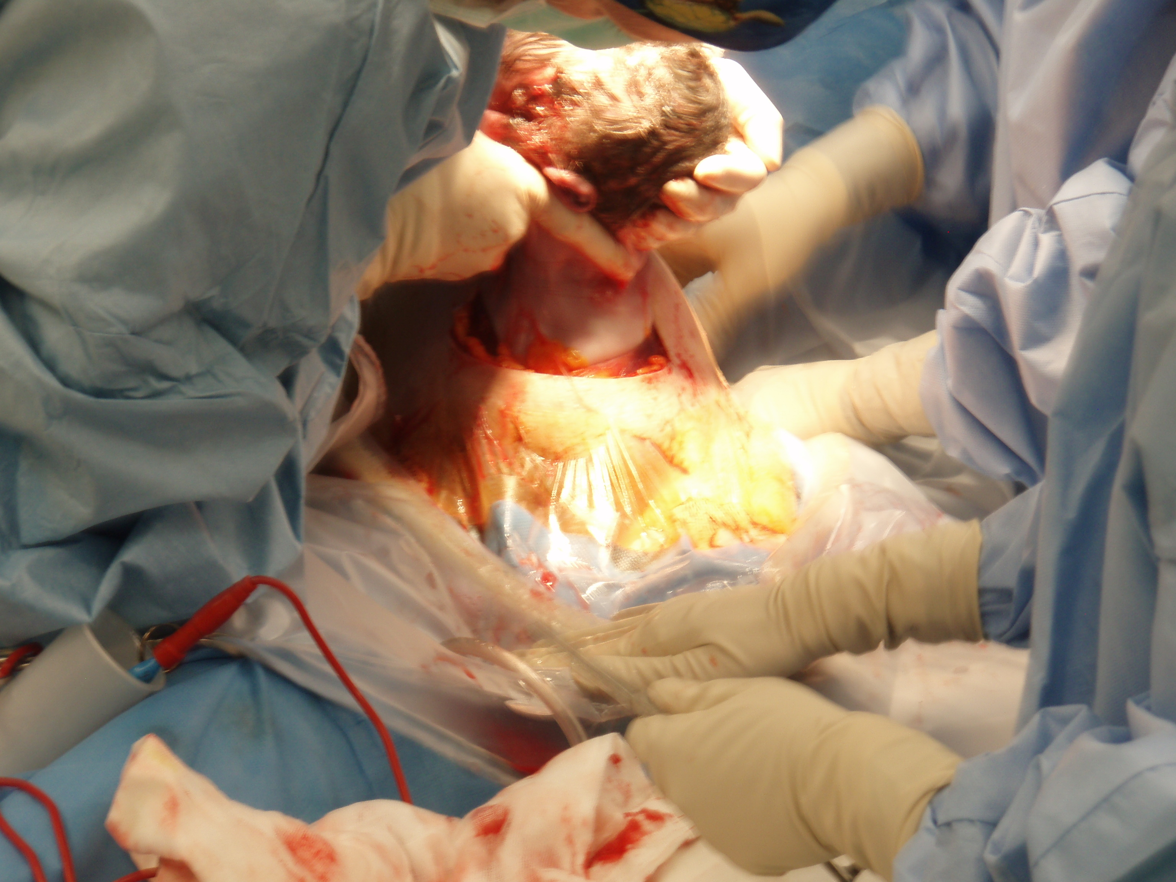

Slide 35
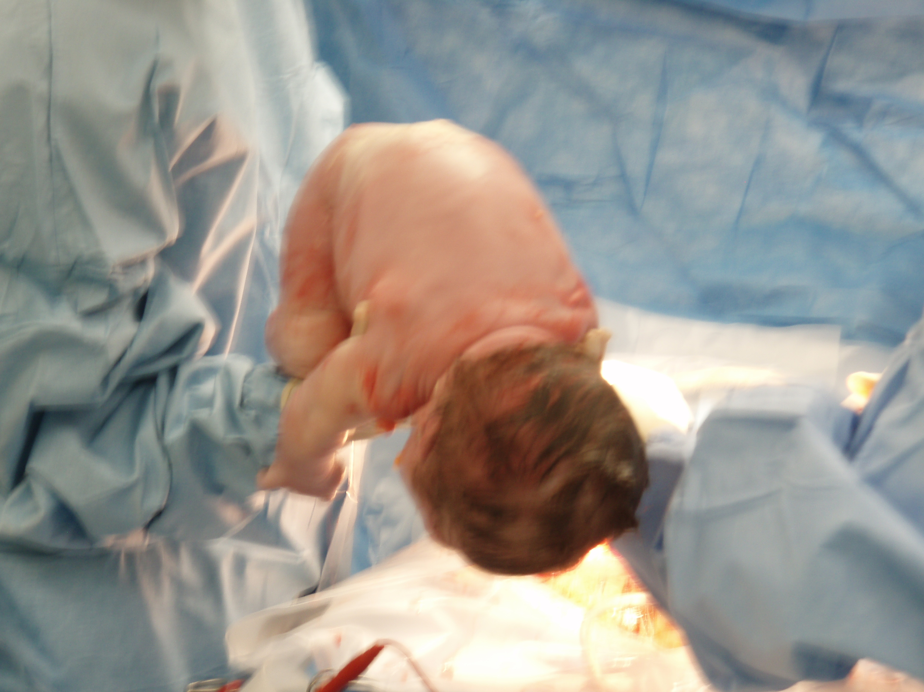

Slide 36
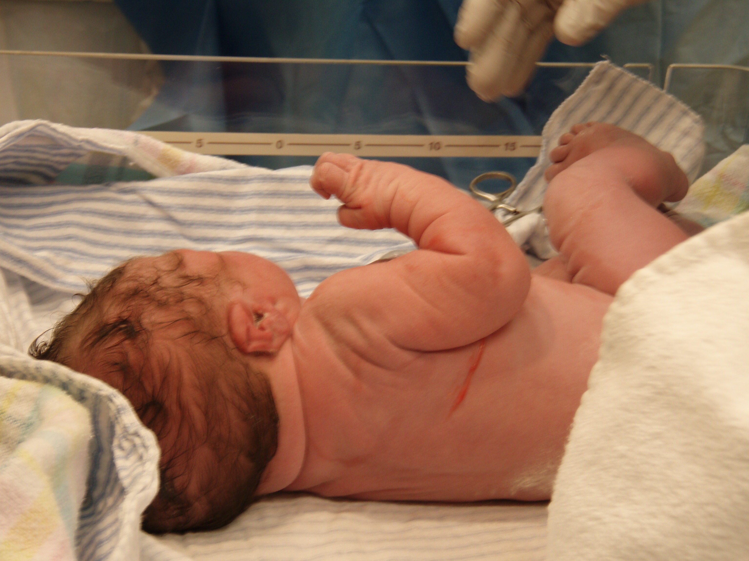

Slide 37
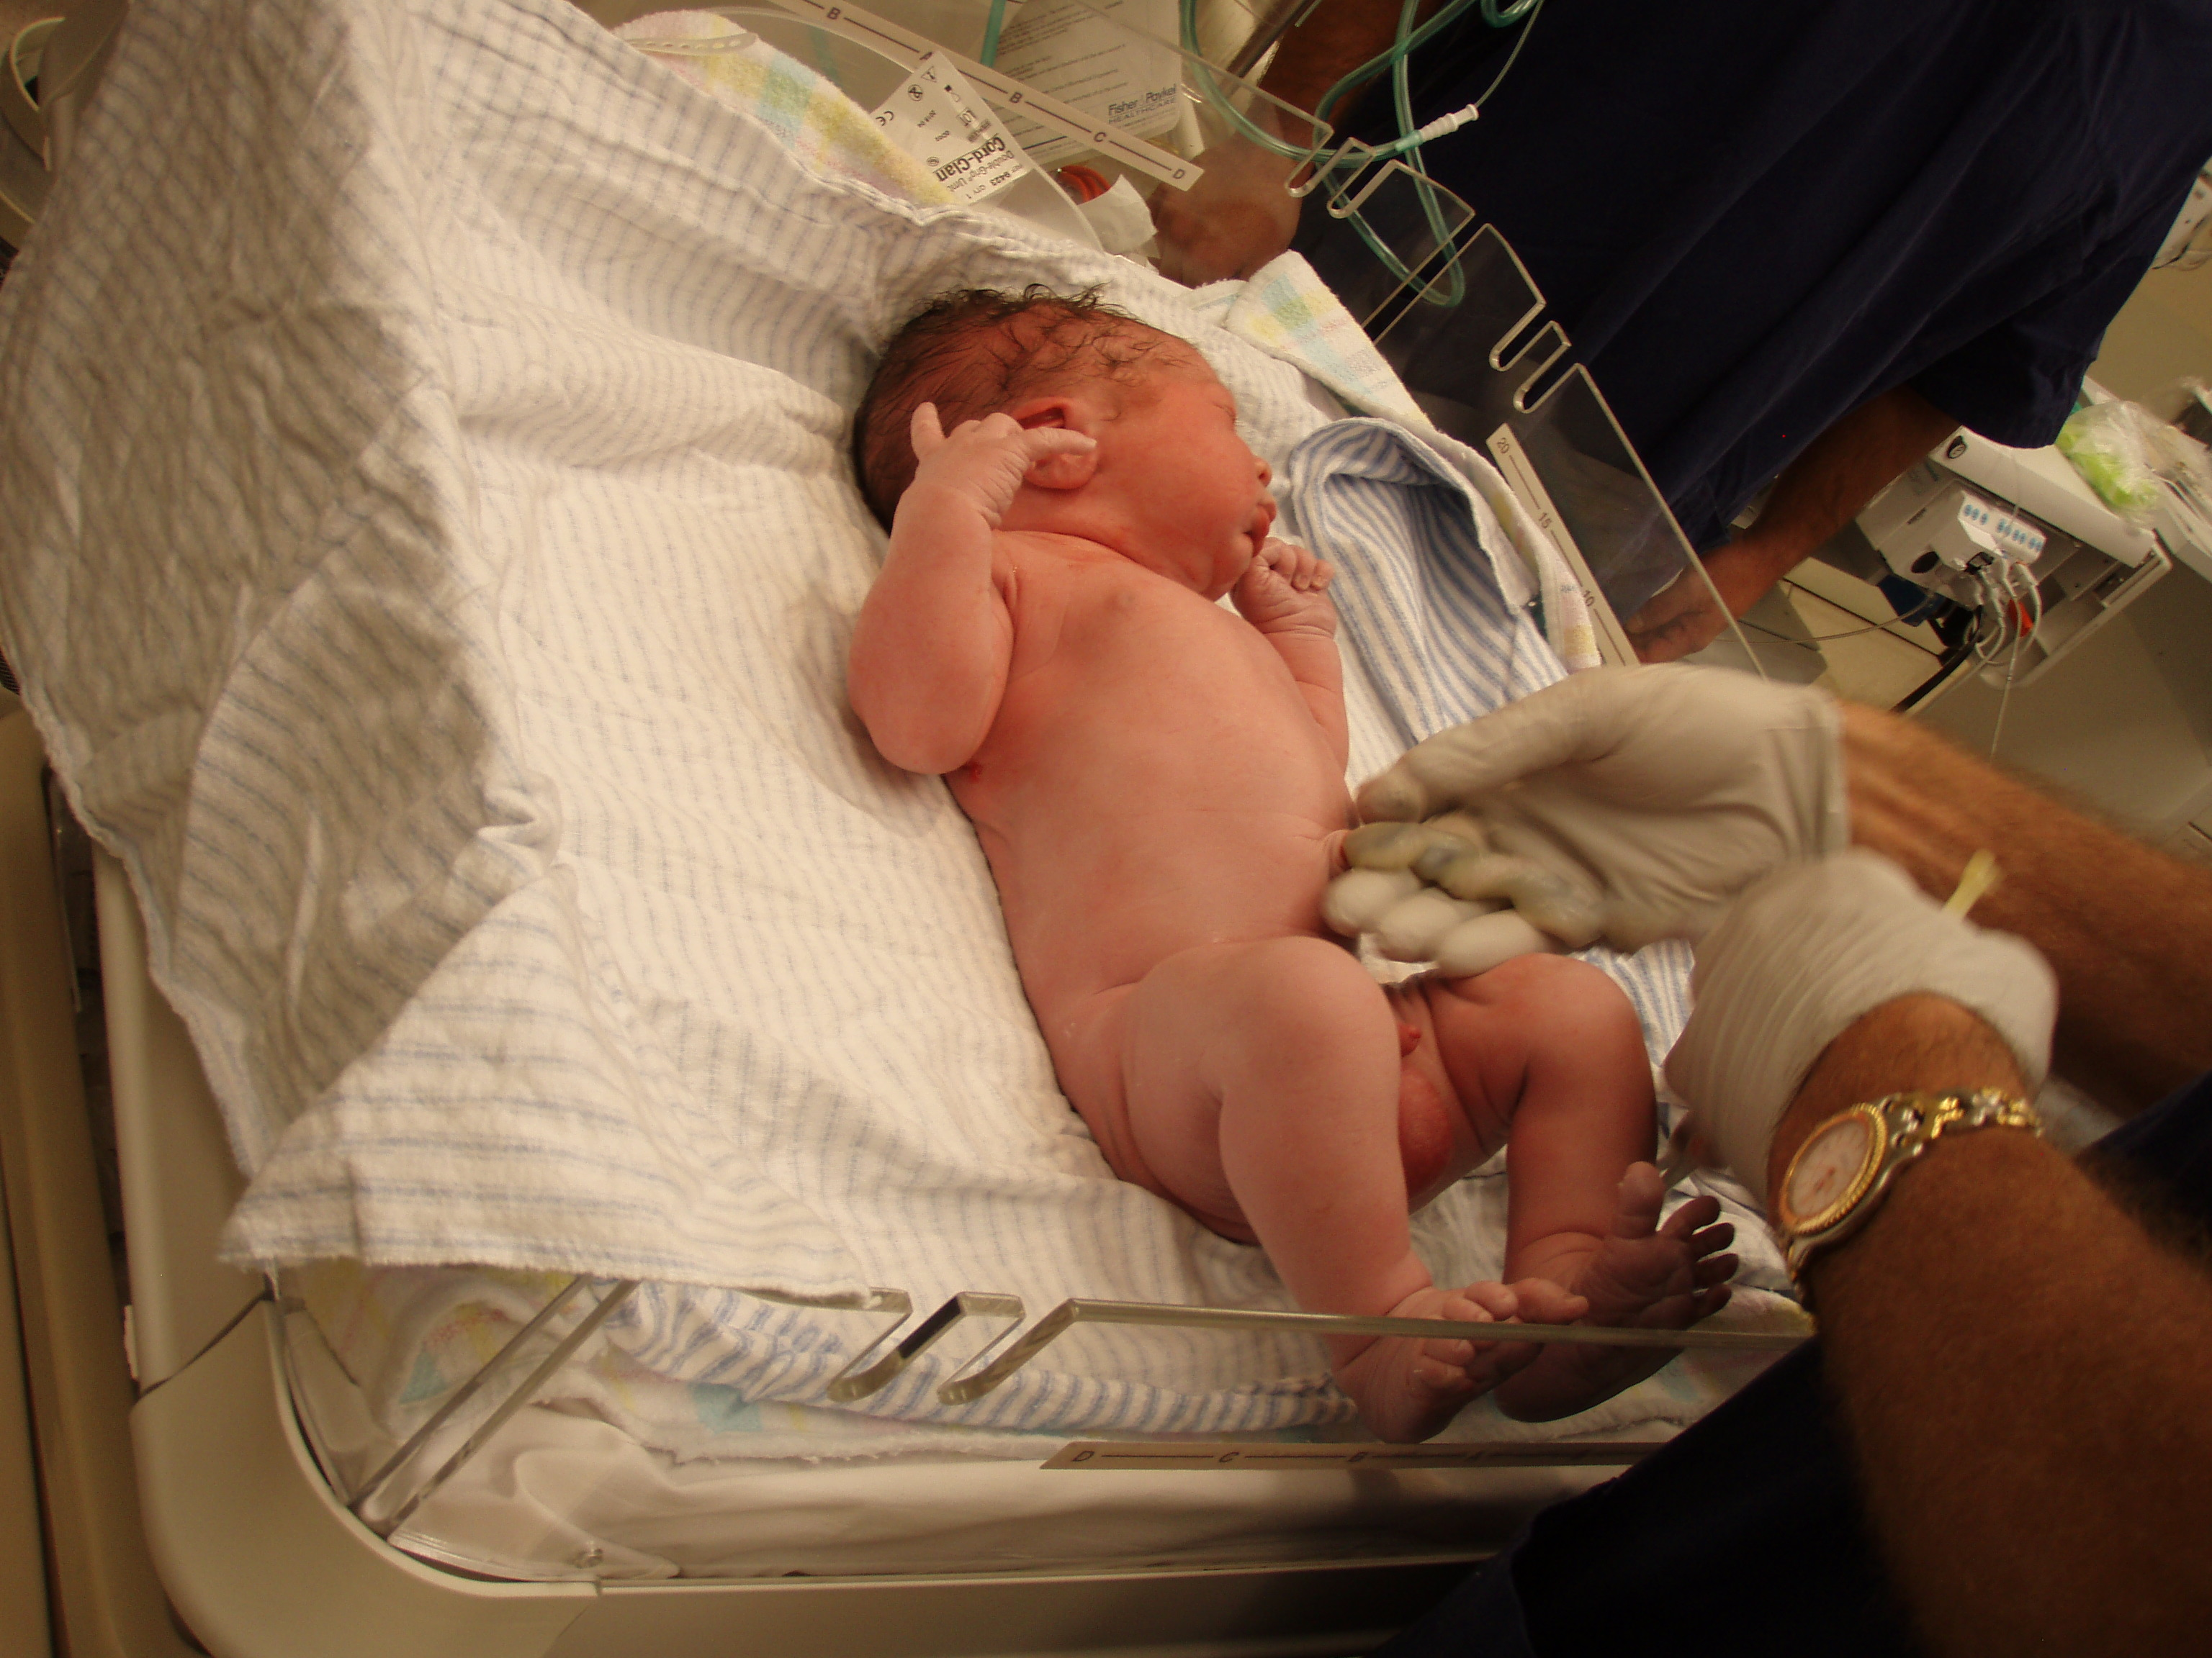

Slide 38
Puerperium
This is the time period post birth until 8 weeks.
During this time a number of changes occur for the mother.
Uterus continues to contract in order to return to original shape.
Uterus discharges a mixture of blood and other tissues (up to 3rd week).
Blood volume reduces.
Pulse rate reduces.

